Slide 1

The Nordic Countries:
Prosperity Despite Redistribution
Professor Hannes H. Gissurarson
Students for Liberty, Brazil
São Paulo, 13 October 2018

Slide 2
Familiar case: Australia v. Argentina
Notes:
Source: Bolt, J. and J. L. van Zanden (2013). The First Update of the Maddison Project; Re-Estimating Growth Before 1820. Maddison Project Working Paper 4. Website: http://www.ggdc.net/maddison/maddison-project/data.htm

Slide 3
Interesting case: Jamaica v. Singapore
Notes:
Source: Bolt, J. and J. L. van Zanden (2013). The First Update of the Maddison Project; Re-Estimating Growth Before 1820. Maddison Project Working Paper 4. Website: http://www.ggdc.net/maddison/maddison-project/data.htm

Slide 4
But What About the Nordic Countries?
The myth, especially in Brazil: social democracy explains Nordic success on most criteria
The facts: Nordic countries have strong liberal (in the old sense) traditions, pursue free trade, uphold rule of law and protect property
Moreover, they have a high level of trust, social cohesion because of homogeneity, transparency, and tradition of hard work, independence, and self-reliance
Notes:
Nima Sanandaji, Scandinavian Unexceptionalism (London: Institute of Economic Affairs, 2015).

Slide 5
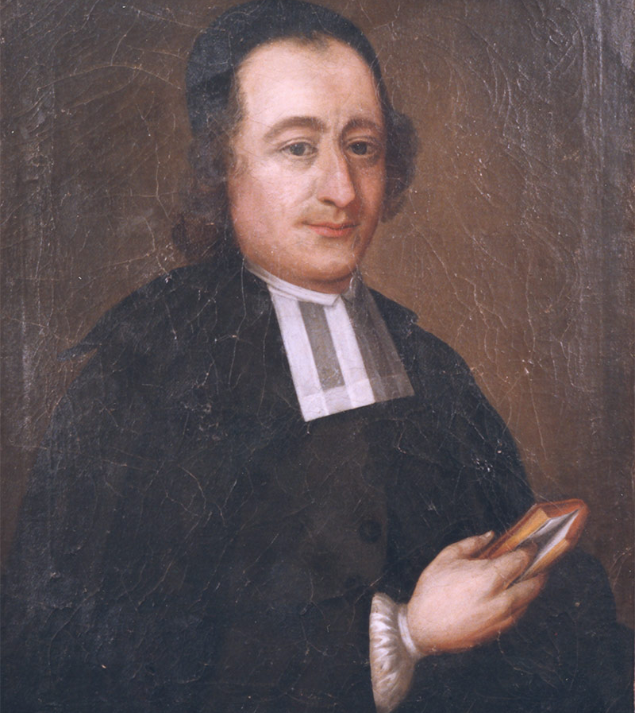
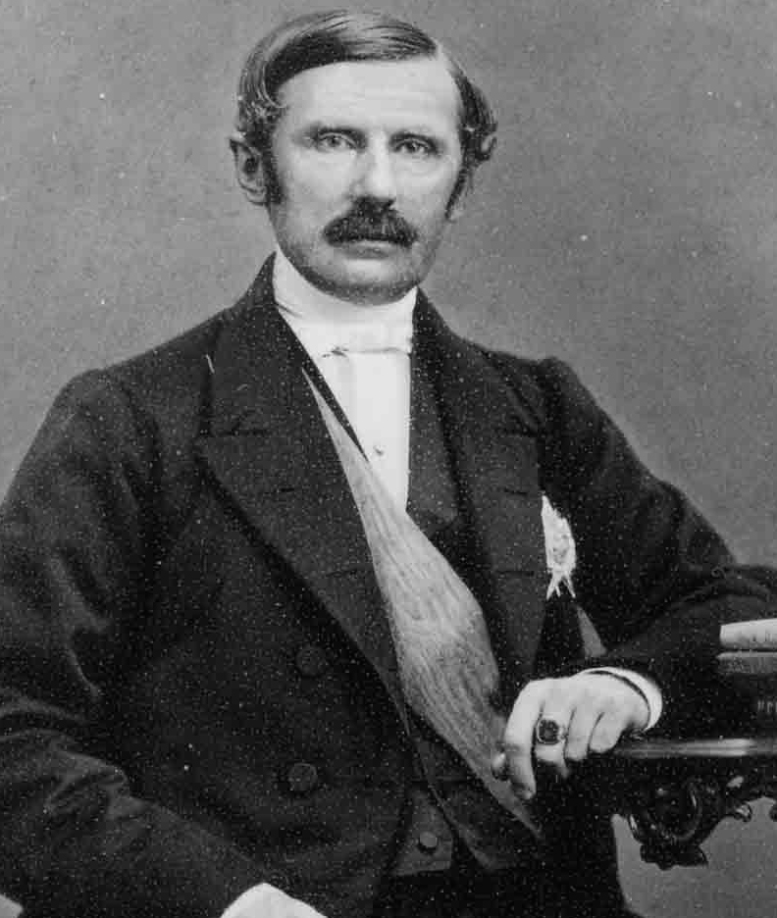
Strong Swedish Liberal Tradition …
Anders Chydenius
Johan August Gripenstedt
Notes:
Johan Norberg, Den svenska liberalismens historia (Stockholm: Timbro, 1998).

Slide 6
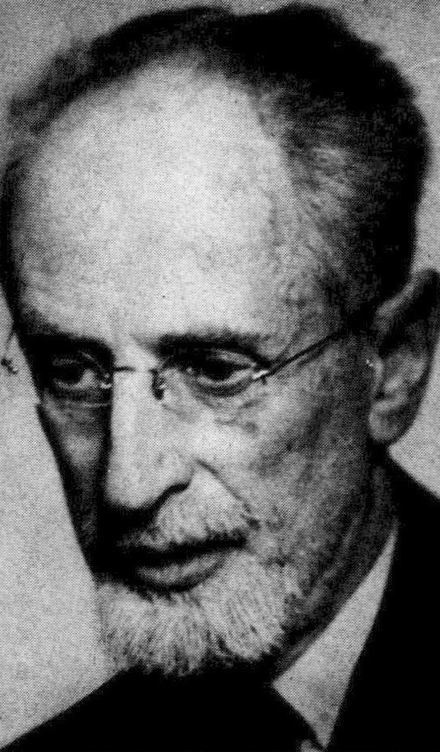
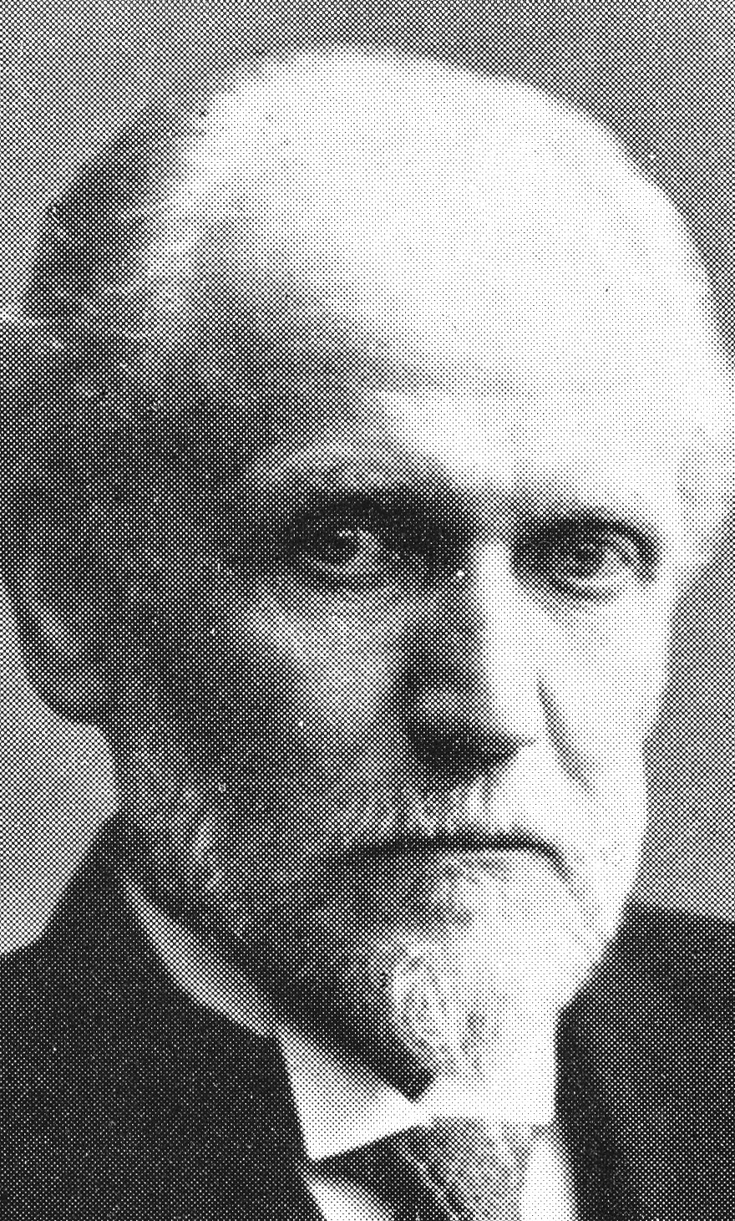
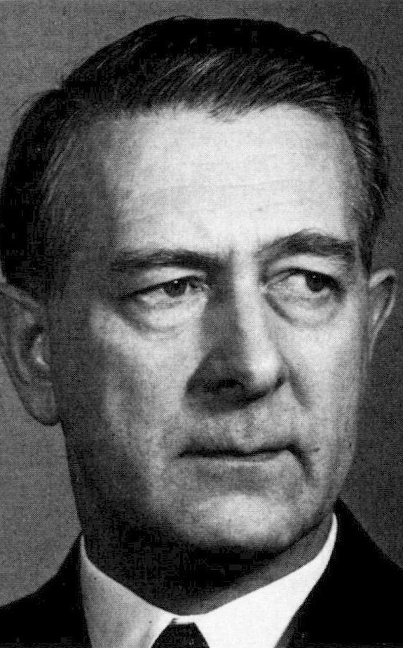
… also in 20th Century
Eli Heckscher
Gustav Cassel
Bertil Ohlin

Slide 7
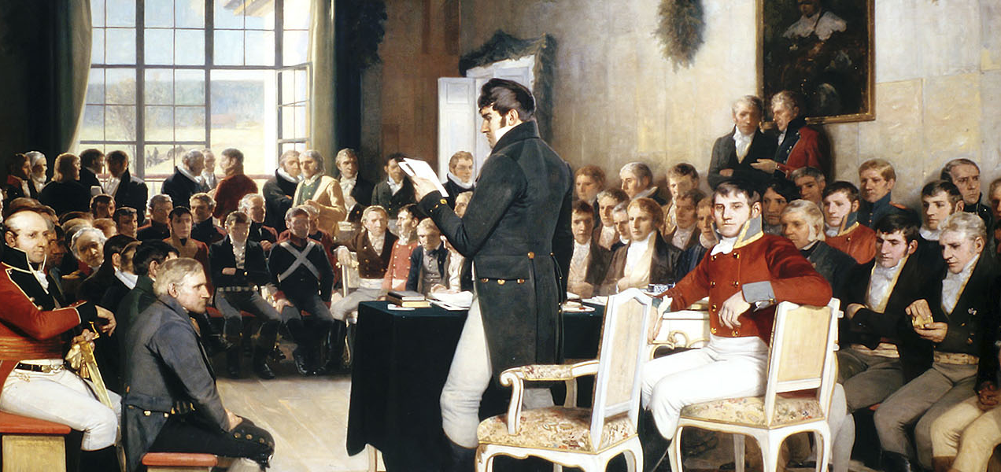
Also in other three Nordic countries
Eidsvoll 17 May 1814 when the Norwegians adopted a very liberal constitution
Notes:
Øystein Sørensen, Liberalismens historie i Norge: Noen hovedlinjer, Ideer om frihet, Vol. 7 (1–2: 1991).

Slide 8
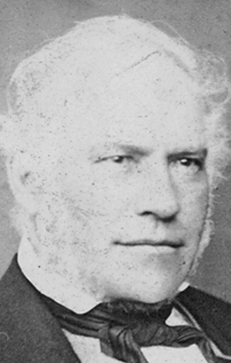
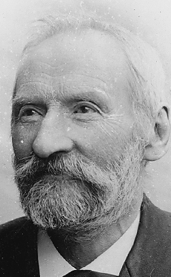
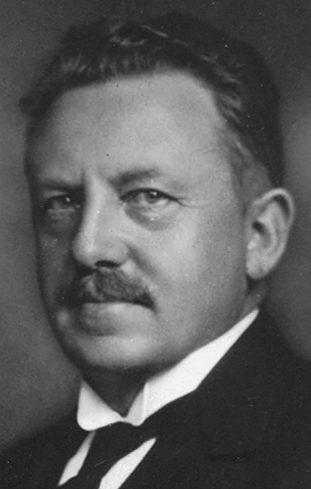
Even Liberals in Little Iceland …
Jon Sigurdsson
Arnljotur Olafsson
Jon Thorlaksson

Slide 9
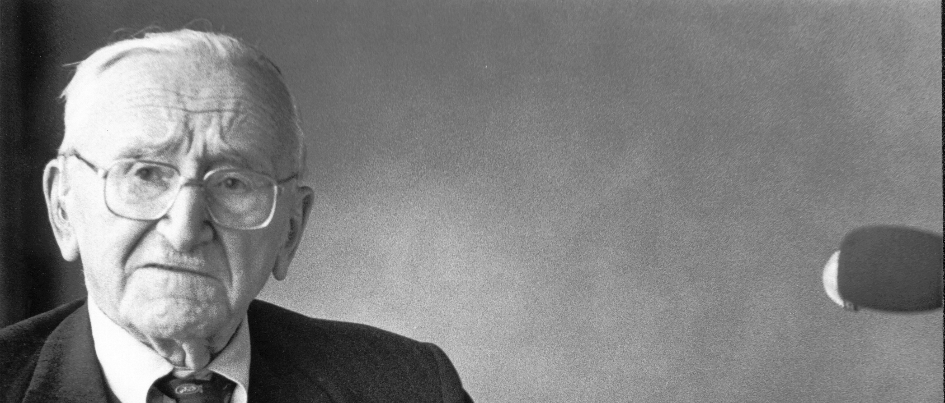
Hayek’s Impact in Nordic countries …
Iceland 5 April 1980
… was 1) in the 1940s to start a serious discussion about central planning, with the result that social democrats abandoned that idea; 2) in the 1980s to inspire a new generation of liberals who sought to extend individual freedom and constrain the power of government

Slide 10
Three Swedish Models
Liberal model, 1850–1970: free trade, low taxes, sound money, abolition of monopolies and privileges; 1870–1936, highest growth rate in world
Social democratic model, 1970–1990: high taxes; relative decline; no job creation in private sector
New mixed model, from 1995: extension of individual choice, lower tax rates and simpler structure, intact safety net

Slide 11
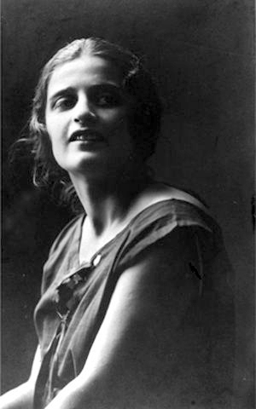
Atlas Shrugged: Sweden 1970–90
In 1870–1970 many entrepreneurs, large companies
1970–1990, capitalists and entrepreneurs, Kamprad (IKEA), Rausing (Tetrapak), etc., left Sweden
Entrepreneurship diminished
Value erosion: worth ethic declined, shirking increased
Almost like a Randian nightmare

Slide 12
All Job Creation in Public Sector
Notes:
Source: Carl Magnus Bjuggren and Dan Johansson (2009), Privat och offentlig sysselsättning i Sverige 1950-2005,
Ekonomisk Debatt, Vol. 37 (1: 2009), 41–53,

Slide 13
Sweden’s Fall and (Partial) Rise
Notes:
Purchasing Power Parity Converted GDP Per Capita Relative to the United States, G-K method, at current prices for Sweden. Heimild: Federal Reserve Bank of St. Louis, Economic Research, heimasíða. Frumheimild: University of Pennsylvania.

Slide 14
Culture Matters: Swedes
Notes:
Sources: Data on the US and Sweden, OECD 2009. GDP per capita: US$, using current PPPs, in OECD in Figures. Paris: OECD Publishing. Data on Swedish-Americans, Sanandaj, Nima 2012. The surprising ingredients of Swedish success — free markets and social cohesion. London: Institute of Economic Affairs, 21.

Slide 15
Comparison of Northern Countries
Notes:
Heimildir: Tölur frá Kanada (Table A.34 gross domestic product per capita, provinces and territories, in current dollars) eru frá Canada Statistics og fyrir árin 2009–2010. Þær eru í Kanadadal, en hann var þá nánast jafngildur Bandaríkjadal. Heimasíða www.statcan.gc.ca Tölur um Norðurlönd eru úr CIA World Factbook (GDP per Capita, PPP, USD) fyrir 2010. Tölur um ríki í BNA eru úr Avery, J.E., Siebeneck, T.P., og Tate, R.P. 2011. Gross Domestic Product by State. Advance Statistics for 2010 and Revised Statistics for 2007–2009. (Breytt hér úr 2005 verðlagi í 2010 verðlag með því að margfalda með 1,10993.) Bureau of Economic Analysis. Heimasíða www.bea.gov

Slide 16
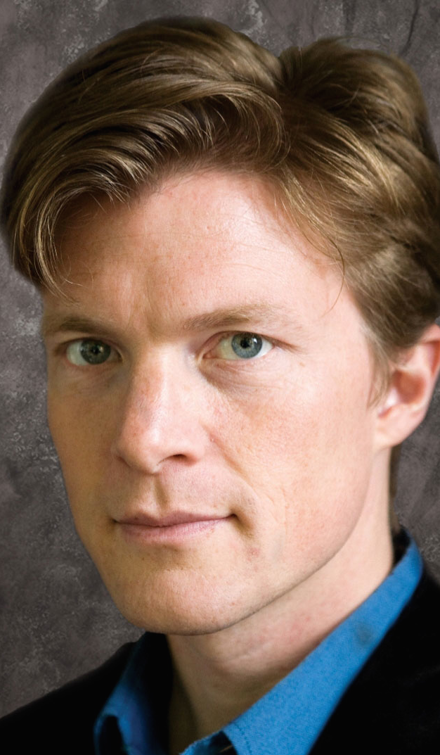
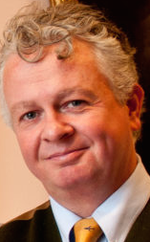
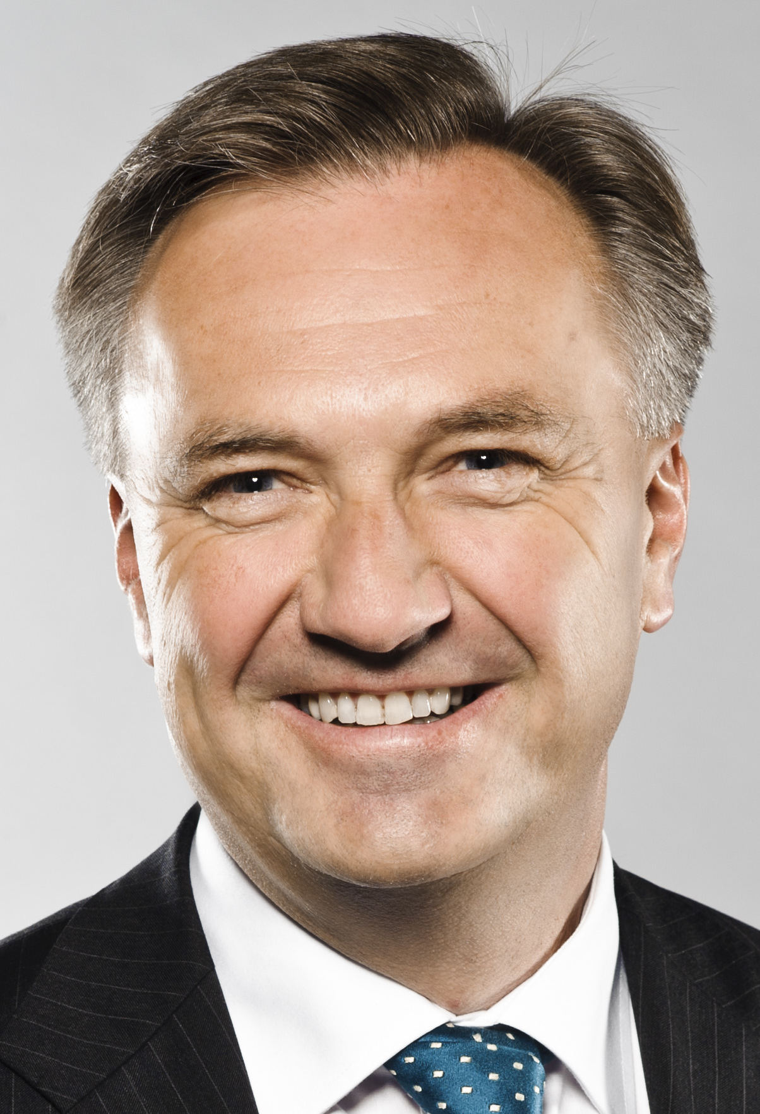
A Liberal Nordic Revival
Johan Norberg
Peter Kurrild-Klitgaard
Lars Peder Nordbakken

Slide 17
A Few Comments on Little Iceland
In Iceland, (classical) liberals gained intellectual hegemony in the 1980s, reinforced by collapse of communism in the 1990s
Comprehensive and successful liberal reforms implemented in 1991–2004 under the leadership of David Oddsson: tax cuts, privatisation, strengthening of pension funds and quota system in fisheries, public administration reform, transparency, free trade and free capital movements with EEA membership

Slide 18
Lower tax rate: Increased revenue
Notes:
Source: OECD Revenue Statistics.

Slide 19
Two Icelandic Innovations
Icelandic Commonwealth in 930–1262: principle of restitution, crimes compensated; private enforcement of law; choice between ‘protective agencies’ or chieftains
Quota system in fisheries since 1975 (comprehensive since 1991): fishing firms hold permanent and transferable rights to harvest a given amount of the total allowable catch, creating an incentive to minimise cost

Slide 20
